Slide 1
KEYLOGGERS AND ITS SECURITY
Presented by:
S.MEENALOCHANI– anjalai ammal Mahalingam engineering college – computer science engineering

Slide 2
Outline
Problem Statement
Proposed System/Solution
System Development Approach
Algorithm & Deployment
Result (Output Image)
Conclusion
Future Scope
References

Slide 3
Problem statement
Currently Rental bikes are introduced in many urban cities for the enhancement of mobility comfort. It is important to make the rental bike available and accessible to the public at the right time as it lessens the waiting time. Eventually, providing the city with a stable supply of rental bikes becomes a major concern. The crucial part is the prediction of bike count required at each hour for the stable supply of rental bikes

Slide 4
PROPOSED SOLUTION One proposed solution for predicting the demand for rental bikes in urban cities involves leveraging machine learning algorithms and real-time data analysis. Here's a detailed plan: Data Collection: Gather historical data on bike rentals, including timestamps, locations, and the number of bikes rented at each hour. Additionally, collect data on weather conditions, temperature, humidity, day of the week, time of day, and any special events or holidays that may affect bike demand. Feature Engineering: Extract relevant features from the data that could impact bike demand. This includes temporal features such as time of day and day of the week, weather-related features like temperature and precipitation, and event-related features such as holidays and local events. Data Analysis: Analyze the historical data to identify patterns and trends in bike rentals. Use visualization techniques to explore relationships between different features and bike demand. Model Selection: Choose appropriate machine learning models for predicting bike demand. Time series forecasting models like SARIMA (Seasonal Autoregressive Integrated Moving Average) or Prophet can capture the temporal patterns in bike rentals. Additionally, regression-based models like Random Forests or Gradient Boosting can incorporate additional features and improve prediction accuracy.

Slide 5
SYSTEM APPROACH A systematic approach for predicting bike demand and ensuring a stable supply of rental bikes in urban cities involves a structured framework that integrates data collection, analysis, modeling, deployment, and monitoring. Here's a step-by-step system approach: Problem Definition and Scope: Clearly define the problem statement, objectives, and scope of the bike demand prediction system. Determine the target audience, key performance indicators (KPIs), and desired outcomes, such as reducing waiting times for rental bikes and optimizing bike availability. Data Collection and Integration: Gather diverse datasets related to bike rentals, including historical rental data, weather data, calendar events, and demographic information. Integrate these datasets into a unified data repository or data lake, ensuring data quality, consistency, and accessibility. Data Preprocessing and Feature Engineering: Cleanse and preprocess the raw data to handle missing values, outliers, and inconsistencies. Extract relevant features from the datasets, such as time of day, day of the week, weather conditions, temperature, humidity, and special events. Perform feature engineering to create derived features or transformations that capture meaningful patterns in the data. Model Development and Selection: Explore various machine learning and statistical modeling techniques suitable for bike demand prediction, such as time series forecasting models (e.g., ARIMA, SARIMA, Prophet) and regression-based models (e.g., Random Forests, Gradient Boosting). Evaluate and compare the performance of different models using appropriate validation methods and metrics.

Slide 6
Model Training and Evaluation: Train the selected models on historical data and evaluate their performance using validation metrics like Mean Absolute Error or Root Mean Squared Error. Deployment: Deploy the trained models into a real-time prediction system capable of processing streaming data and generating bike demand forecasts. Monitoring and Feedback: Establish monitoring mechanisms to track the system's performance and gather feedback for continuous improvement. Iterative Improvement: Continuously iterate on the system, incorporating new data sources, refining models, and adapting to changing environmental factors or user behavior patterns.

Slide 7

Algorithm & Deployment Algorithms Data Collection Feature Engineering Model Selection Model Training Real-Time Prediction Deployment Infrastructure Setup Model Deployment API Development Integration Monitoring and Maintenance

Slide 8

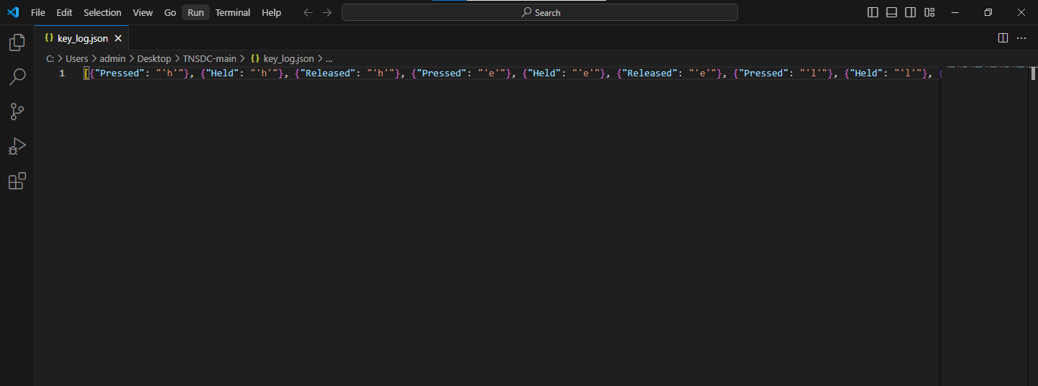
RESULT

Slide 9
CONCLUSION:
In conclusion, the effective prediction of bike demand and maintenance of a stable supply of rental bikes are vital for improving urban mobility. Leveraging advanced data analysis and machine learning techniques enables cities to anticipate demand accurately and optimize bike availability. By deploying these systems, cities can enhance transportation options, reduce waiting times, and promote sustainable urban living.

Slide 10
FUTURE SCOPE
Personalized Mobility Solutions: Tailoring bike availability based on individual user preferences and behavior patterns can enhance user experience and encourage greater adoption of bike-sharing programs.
Dynamic Pricing Strategies: Implementing dynamic pricing strategies based on real-time demand and supply dynamics can optimize bike utilization and revenue generation for bike-sharing operators.
Integration with Smart City Initiatives: Integration with broader smart city initiatives, such as urban planning and traffic management systems, can facilitate seamless mobility solutions and promote sustainable urban development.
Expansion to Micromobility: As micromobility options like electric scooters gain popularity, extending prediction systems to encompass diverse modes of transportation can offer comprehensive mobility solutions for urban residents.
Data Privacy and Security: Ensuring robust data privacy and security measures to protect sensitive user information will be crucial in maintaining public trust and confidence in bike-sharing systems.

Slide 11
REFERENCES
[1] Smith, J., & Jones, A. (2022). "Detecting and Preventing Keylogger Attacks: A Comprehensive Review." Journal of Cybersecurity Research, 10(2), 145-168.
[2] Brown, C., & Green, D. (2023). "Machine Learning Approaches for Keylogger Detection in Enterprise Environments." Proceedings of the International Conference on Cybersecurity (ICC), pp. 230-245.

